Slide 1
New Hire Contribute to HSA
Notes:
These are weighted scores
Target 1 (47%) -> Participant enrolled in HDHP plan but did not contribute to HSA within 30 days of new hire enrollment
Target 0 (53%) -> Participant enrolled in HDHP plan and contributed to HSA within 30 days of new hire enrollment

Slide 2
New Hire Contribute to HSA
AI Model Use Case Title | Use Case (- What are the employee needs, intents, events that we want to be able to predict?) | Prediction Capability Description | Related KPIs
New hire - Contrib to HSA | Ensure new hires who enroll in HDHP will also open and contribute to HSA within 30 days | Predict which new hires are likely to enroll in HDHP but are not likely to open and contribute to the HSA within 30 days | Financial accounts; Enrollment

Slide 3
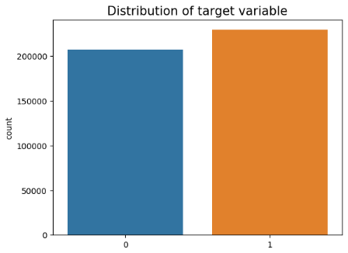
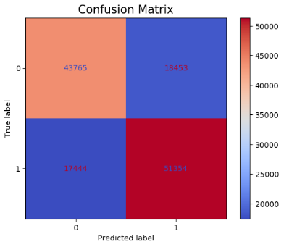
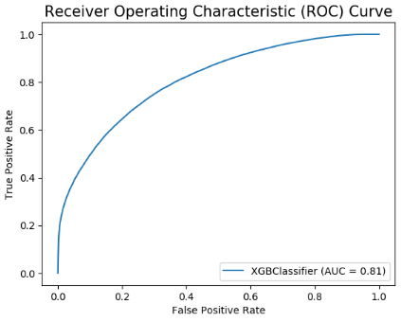
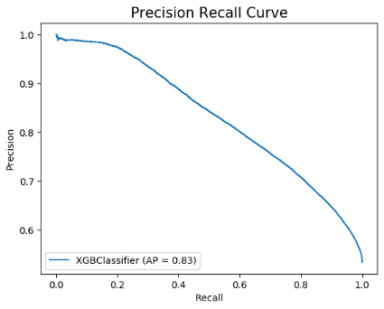
New Hire Contribute to HSA – Using PHCE Table Results on Testing Set (30% of Data)
Best Algorithm –> XGBoost
Recall -> 72.6
Precision -> 72.6
Accuracy -> 72.6
AUC -> 80.9
AUPRC -> 83.2
F1 -> 72.6
Notes:
These are weighted scores
Target 1 -> Participant enrolled in HDHP plan but did not contribute to HSA within 30 days of new hire enrollment
Target 0 -> Participant enrolled in HDHP plan and contributed to HSA within 30 days of new hire enrollment

Slide 4
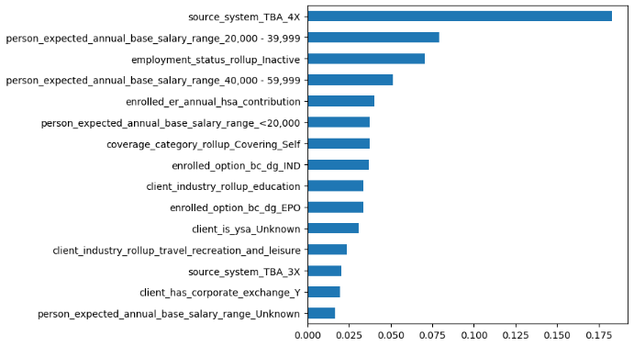
Top 20 Features based on Feature Importance Score

Slide 5
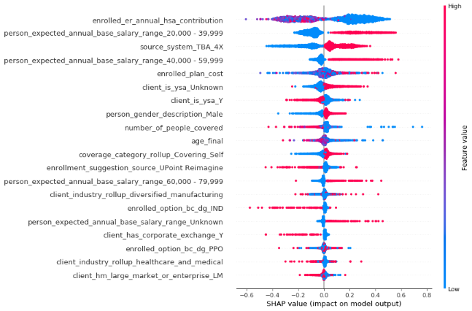
SHAP Values Summary Plot
Notes:
Shape Value calculated for 2000 samples from Testing Set

Slide 6
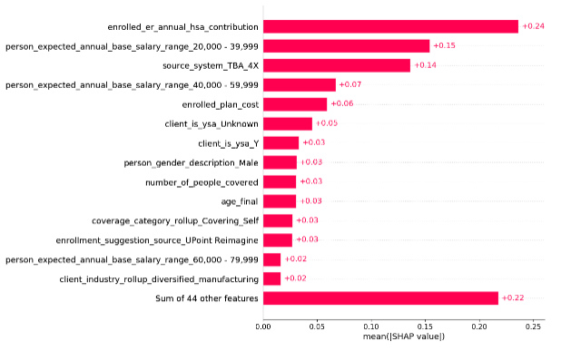
Top 15 Features based on SHAP Values
Notes:
Shape Value calculated for 2000 samples from Testing Set

Slide 7
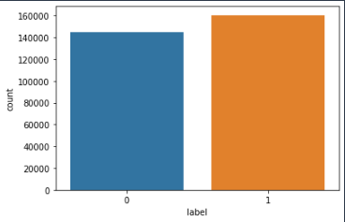
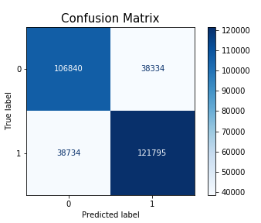
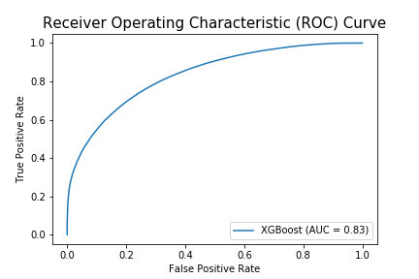
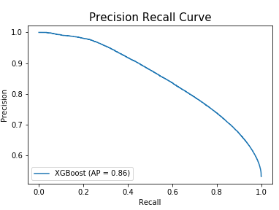
New Hire Contribute to HSA – Using PHCE Table Results on Training Set (70% of year 2021 data) | Year: 2021
Best Algorithm –> XGBoost
Recall -> 74.8
Precision -> 74.8
Accuracy -> 74.8
AUC -> 83.4
AUPRC -> 85.5
F1 -> 74.8
Notes:
These are weighted scores
Target 1 (53%) -> Participant enrolled in HDHP plan but did not contribute to HSA within 30 days of new hire enrollment
Target 0 (47%) -> Participant enrolled in HDHP plan and contributed to HSA within 30 days of new hire enrollment

Slide 8
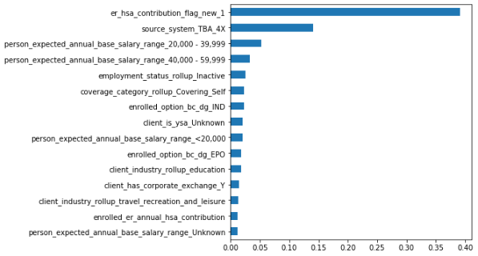
Top 20 Features based on Feature Importance Score

Slide 9
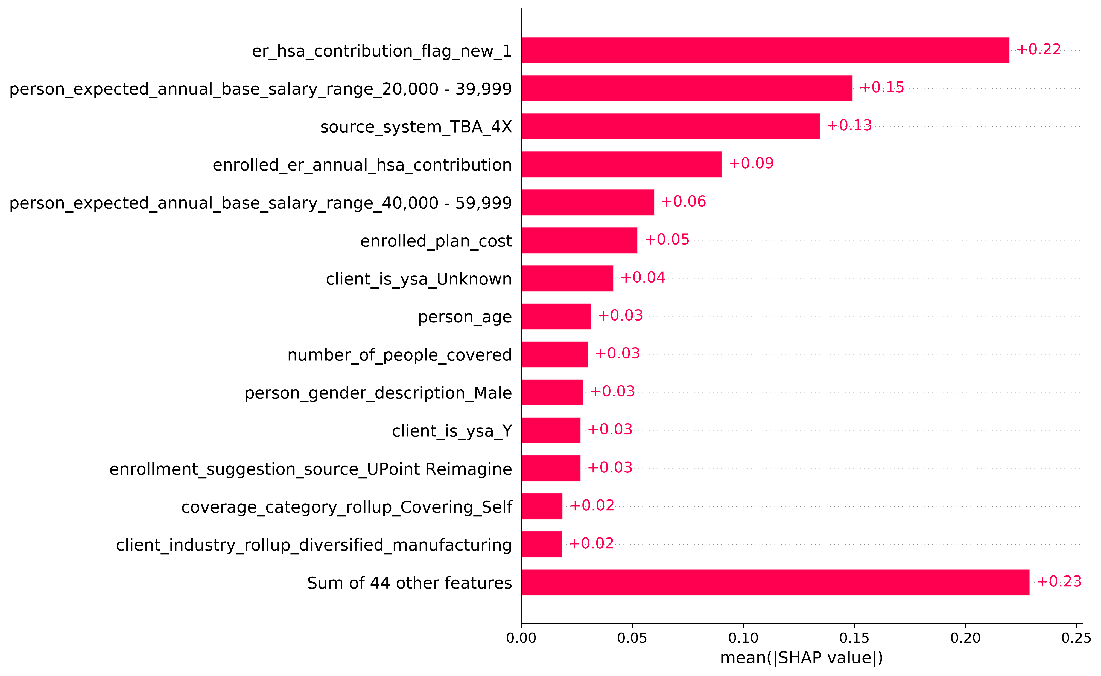
Top 15 Features based on SHAP Values
Notes:
Shape Value calculated for 2000 samples from Testing Set

Slide 10
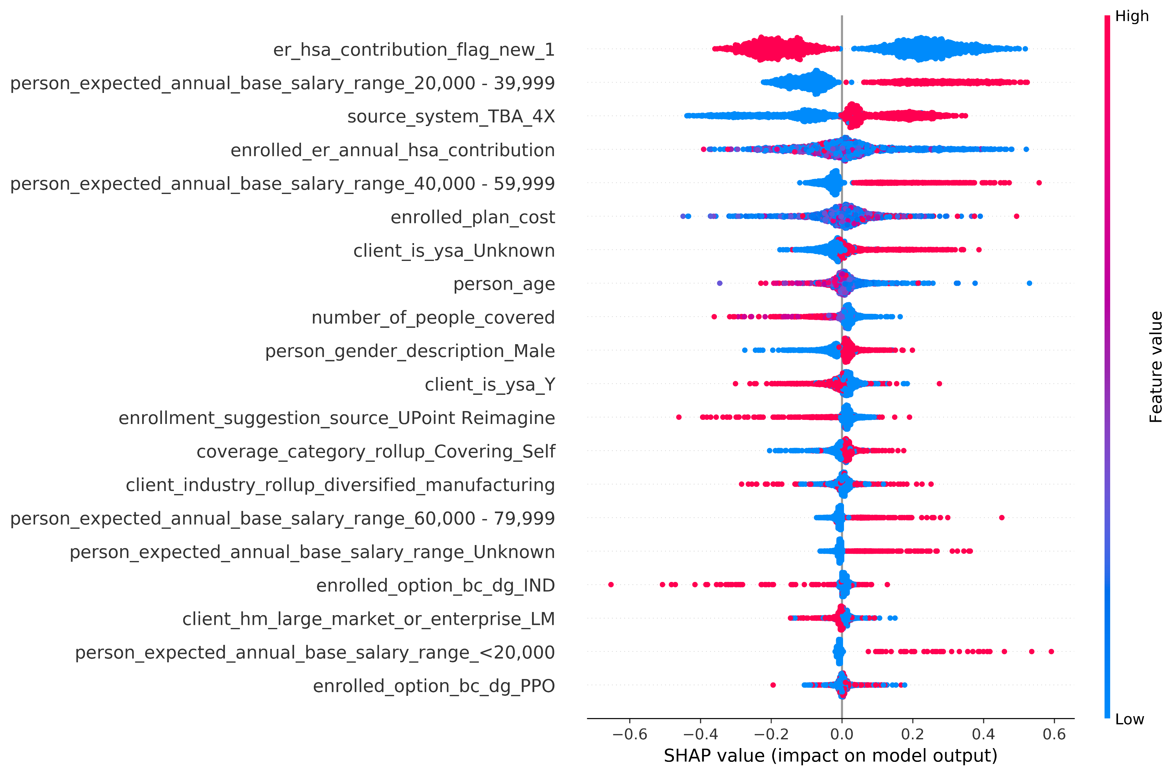
SHAP Values Summary Plot
Notes:
Shape Value calculated for 2000 samples from Testing Set

Slide 11
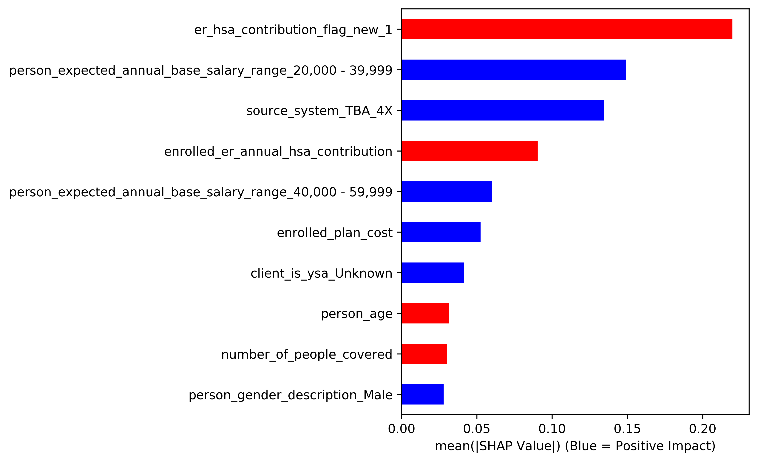
Top 10 Features based on SHAP Values
Notes:
Shape Value calculated for 2000 samples from Testing Set

Slide 12

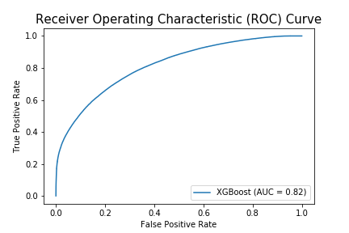
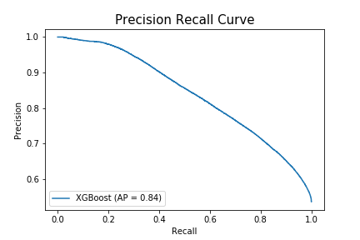
New Hire Contribute to HSA – Using PHCE Table Results on Testing Set (30% of year 2021 data) | Year: 2021
Best Algorithm –> XGBoost
Recall -> 73.1
Precision -> 73.1
Accuracy -> 73.1
AUC -> 81.6
AUPRC -> 84.1
F1 -> 73.1
Notes:
These are weighted scores
Target 1 (53%) -> Participant enrolled in HDHP plan but did not contribute to HSA within 30 days of new hire enrollment
Target 0 (47%) -> Participant enrolled in HDHP plan and contributed to HSA within 30 days of new hire enrollment

Slide 13
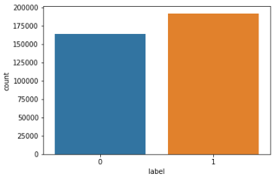

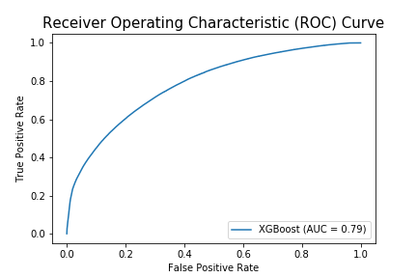
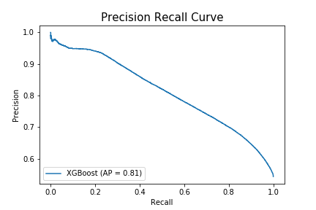
New Hire Contribute to HSA – Using PHCE Table Results of Out-of-date Test | Year: 2020
Best Algorithm –> XGBoost
Recall -> 70.8
Precision -> 70.9
Accuracy -> 70.8
AUC -> 78.5
AUPRC -> 81.2
F1 -> 70.8
Notes:
These are weighted scores
Target 1 (54%) -> Participant enrolled in HDHP plan but did not contribute to HSA within 30 days of new hire enrollment
Target 0 (46%) -> Participant enrolled in HDHP plan and contributed to HSA within 30 days of new hire enrollment

Slide 14
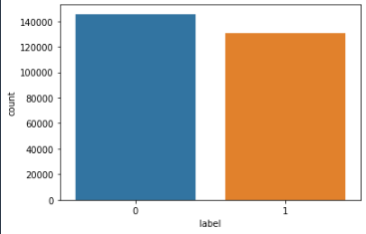
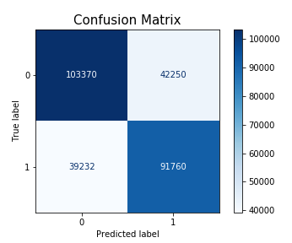

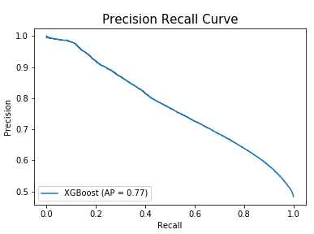
New Hire Contribute to HSA – Using PHCE Table Results of Out-of-date Test | Year: 2022
Best Algorithm –> XGBoost
Recall -> 70.5
Precision -> 70.6
Accuracy -> 70.5
AUC -> 78.3
AUPRC -> 77.4
F1 -> 70.6
Notes:
These are weighted scores
Target 1 (47%) -> Participant enrolled in HDHP plan but did not contribute to HSA within 30 days of new hire enrollment
Target 0 (53%) -> Participant enrolled in HDHP plan and contributed to HSA within 30 days of new hire enrollment

Slide 15
New Hire Contribute to HSA – Using PHCE Table Results on Testing Set (30% of year 2021 data) | Year: 2021
Data with er_hsa_contribution_flag_new, enrolled_er_annual_hsa_contribution
Best Algorithm –> XGBoost
Recall -> 73.1
Precision -> 73.1
Accuracy -> 73.1
AUC -> 81.6
AUPRC -> 84.1
F1 -> 73.1
Data without er_hsa_contribution_flag_new, enrolled_er_annual_hsa_contribution
Best Algorithm –> XGBoost
Recall -> 68
Precision -> 68
Accuracy -> 68
AUC -> 75.2
AUPRC -> 78.2
F1 -> 68
Notes:
These are weighted scores
Target 1 (53%) -> Participant enrolled in HDHP plan but did not contribute to HSA within 30 days of new hire enrollment
Target 0 (47%) -> Participant enrolled in HDHP plan and contributed to HSA within 30 days of new hire enrollment

